Slide 1
Product Management Project

Slide 2
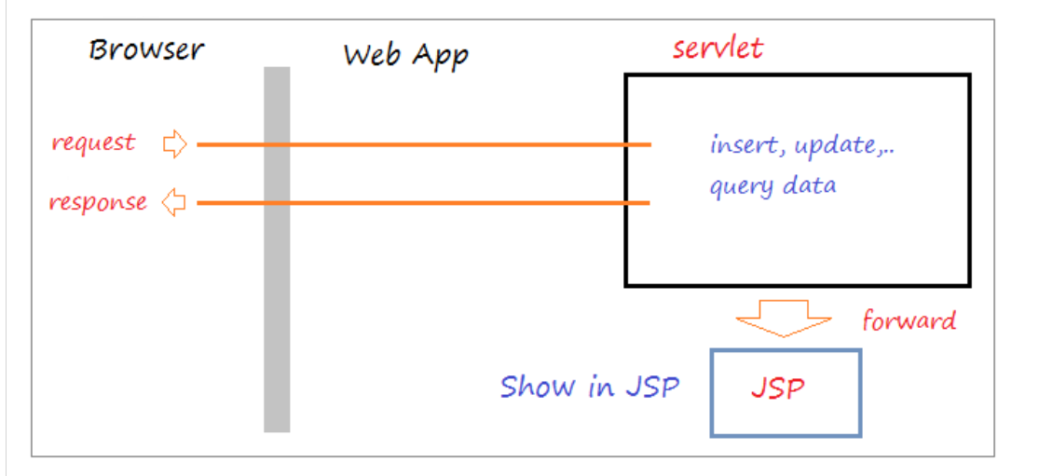
The principle when programming Servlet + JSP

Slide 3
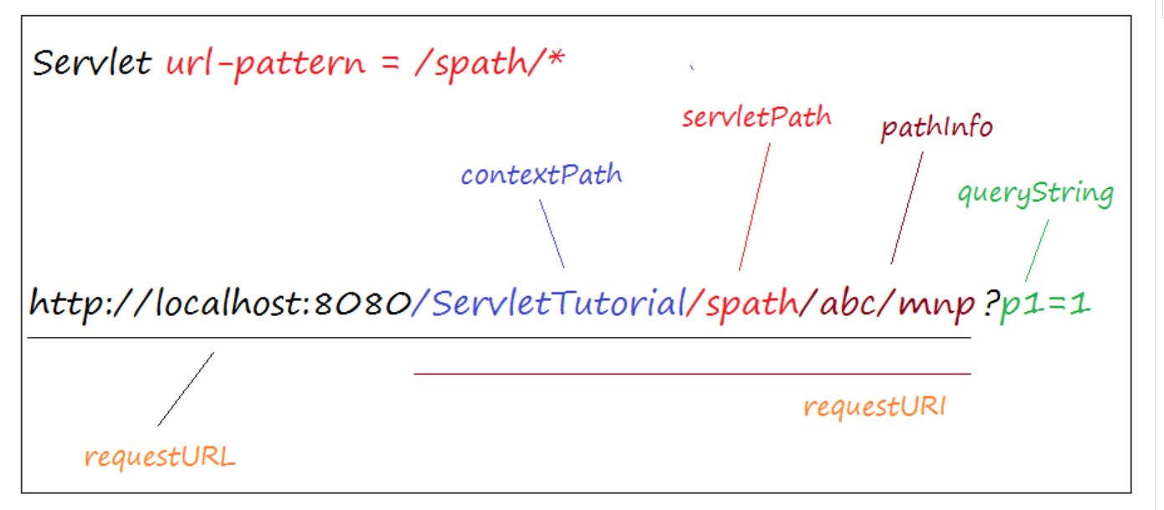
Create Servlet Filter connect to Database

Slide 4
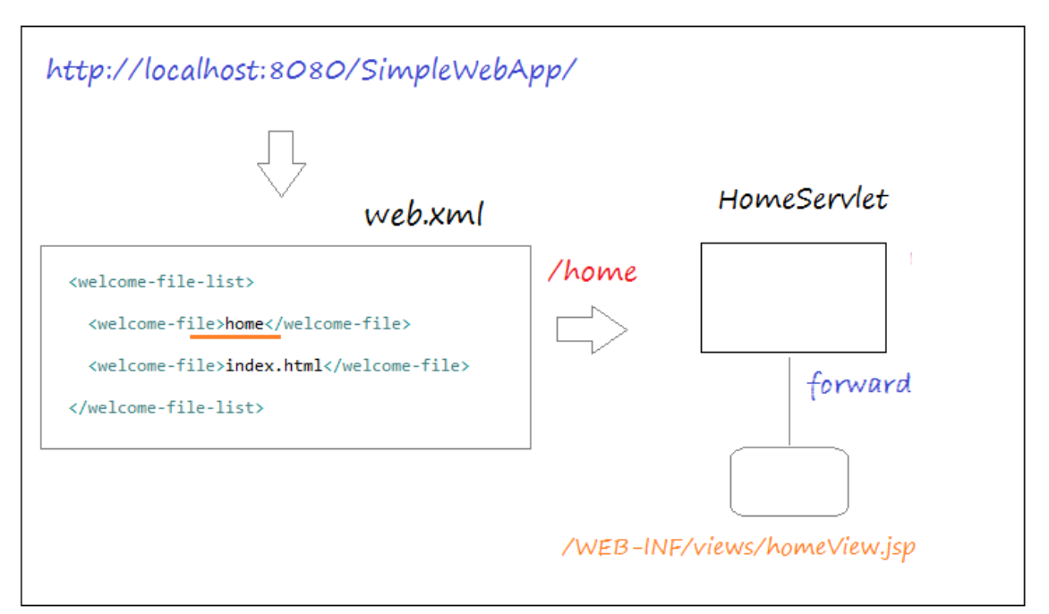

Slide 5
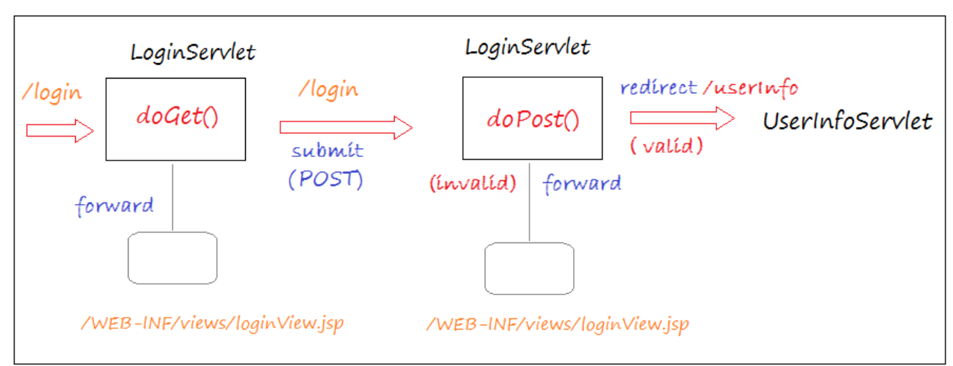
Login Page - LoginServlet

Slide 6
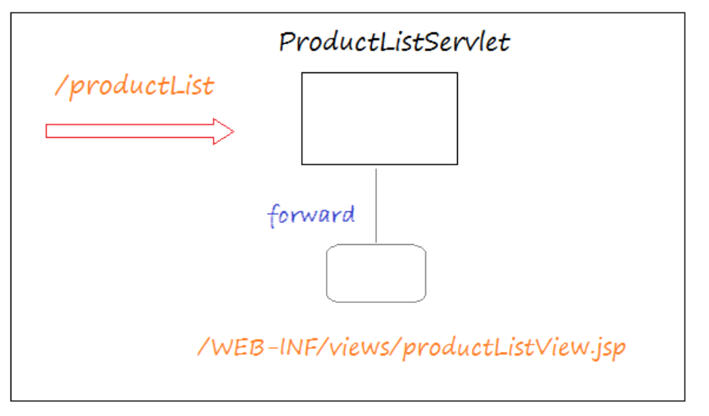
Product List Page

Slide 7
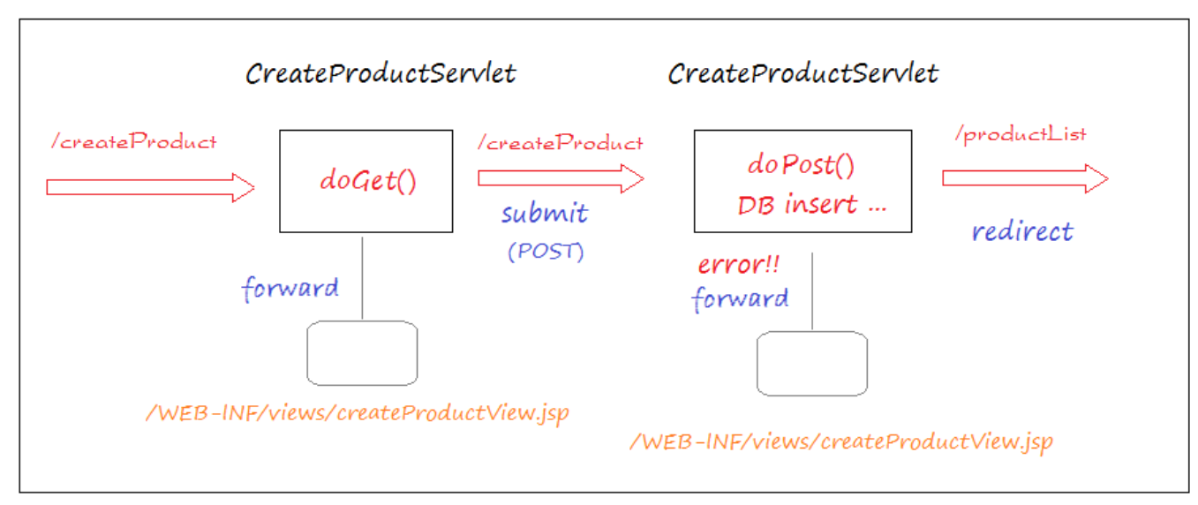
Add Product Page

Slide 8
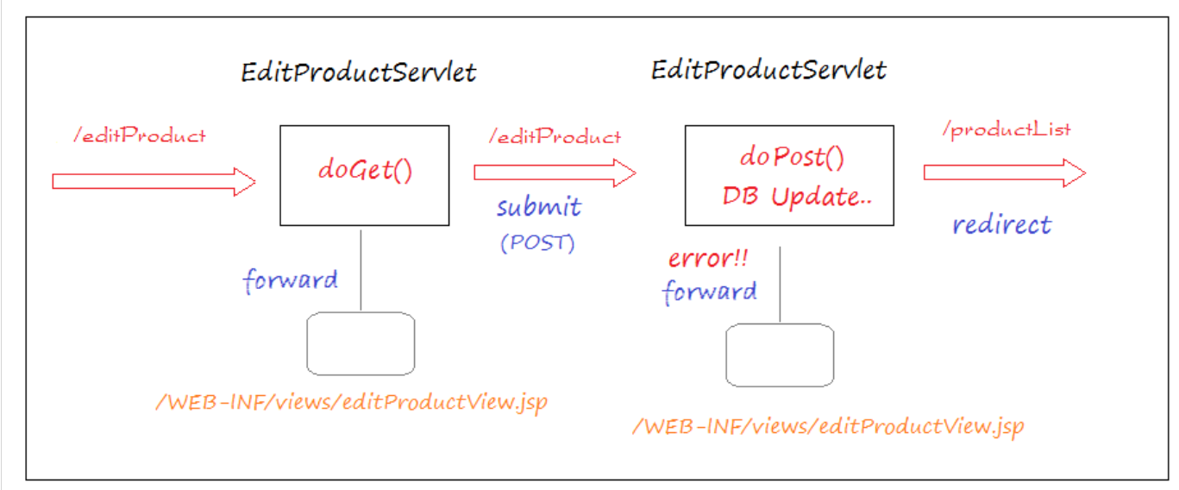
Edit Product Page

Slide 9
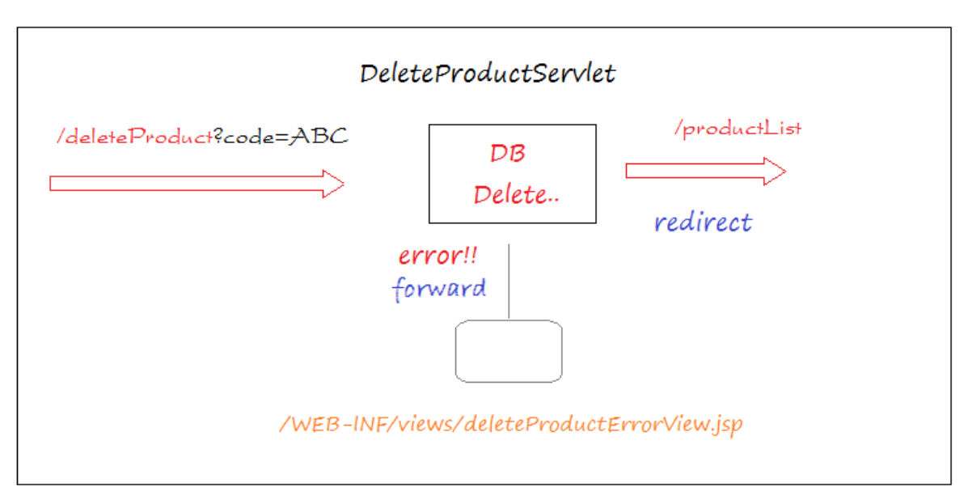
Delete Product

